Slide 1
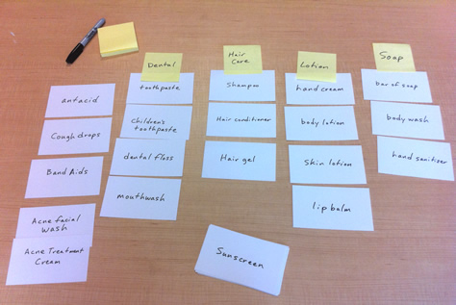
Card Sorting
Jianwei Lai
jlai12@ilstu.edu

Slide 2

Today’s Content
Lecture: Card Sorting
Activity: Online Card sorting

Slide 3
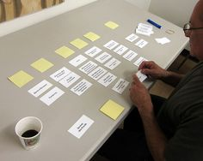
What is Card Sorting?
Card sorting is a method used to help design or evaluate the information architecture of a site.
In a card sorting session, participants organize topics into categories that make sense to them and they may also help you label these groups.
To conduct a card sort, you can use actual cards, pieces of paper, or one of several online card-sorting software tools.

Slide 4
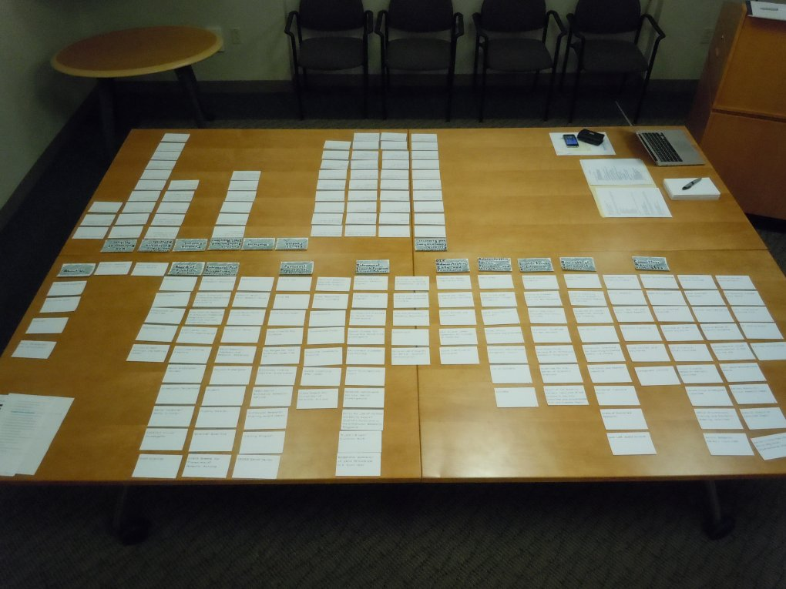
Benefits of Card Sorting
Card sorting will help you understand your users' expectations and understanding of your topics.
Knowing how your users group information can help you:
Build the structure for your website
Decide what to put on the homepage
Label categories and navigation

Slide 5
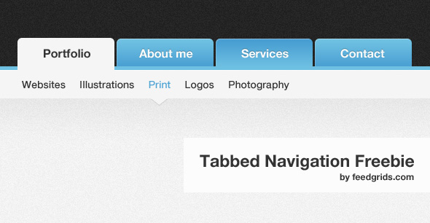
What does it deliver?
Use card sorting to find out how people think your content should be organized and get the user insights you need to make informed information architecture decisions.
Card sorting is a quick and easy way to design an
information architecture,
workflow,
menu structure or
website navigation paths.

Slide 6
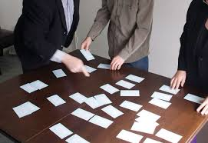
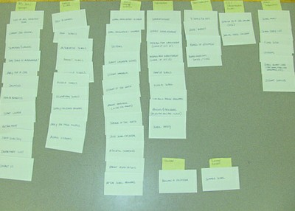
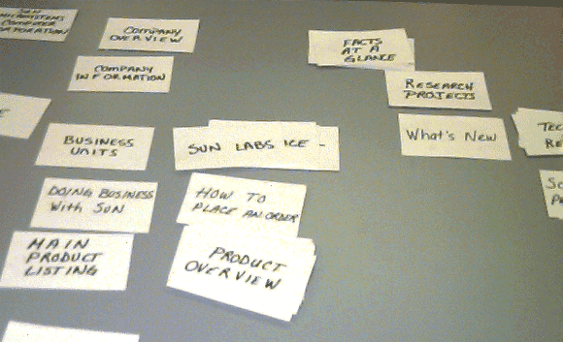
Traditional Methods

Slide 7
Open and Closed Card Sorting
Open Card Sort: Participants are asked to organize topics from content within your website into groups that make sense to them and then name each group they created in a way that they feel accurately describes the content. Use an open card sort to learn how users group content and the terms or labels they give each category.
Closed Card Sort: Participants are asked to sort topics from content within your website into pre-defined categories. A closed card sort works best when you are working with a pre-defined set of categories, and you want to learn how users sort content items into each category.
Notes:
need open card sorting if you want to:
find out how people understand and conceptualize your information
find out where people expect to find information when they land on your website
generate ideas for how to structure and label your website information
establish if your different user groups think in different ways about your information.
You know you need closed card sorting if you want to:
find out if people agree on where your information is best placed within existing categories
pinpoint unclear or misleading category labels based on mixed results and fix them
reduce the number of categories you have based on which categories are ignored the most
Aside from how you structure your website content, you can also use closed card sorting to prioritize and rank features, products, search filters, and so on based on criteria such as 'Important' to 'Unimportant', or 'Use often' to 'Use never.'
You'll run a hybrid card sort like this if you:
want to generate ideas for grouping your information and want to give people a category pattern to take inspiration from
see high agreement on some categories after an open card sort, but need clarity on some less certain groupings

Slide 8
How does it work?
Cards: Your “cards” are the content items from your website that you'd like to study.
We ask people to sort these cards into groups to help you understand your users' mental models.

Slide 9
Best Practices (1/2)
Limit the number of cards. It is tempting to want the participant to sort "ALL" of your content, but be mindful of participant fatigue.
If possible, randomize the order of presentation so that each piece of content has a chance to be sorted earlier in the session.
Provide the participants with an estimate of how long the card sort will take before beginning the session to help them better gauge the required time and effort.

Slide 10
Best Practices (2/2)
Consider an open sort as part 1 and a closed sort as part 2 of your process.
One allows you to learn what goes together,
while 2 allows you to really test out your labels to see if they are intuitive to your participants.

Slide 11
How to Conduct a Card Sort
Prepare the cards
Set-up the session
Lead the session
Analyze your data

Slide 12
Prepare the cards (1/2)
Create your list of content topics. Topics can be phrases or words, very specific or more general. As a suggestion, limit yourself to 50-60 topics or less. This means there might not be a card to sort for every page on the site.
For a new site, list the content topics of types of information that you are likely to have on the site
For an existing site, list the most important / popular types of content

Slide 13
Prepare the cards (2/2)
Decide whether you will be doing a physical card sort or using online card-sorting software.
If you are using online card-sorting software, consult the software instructions.
If you will be conducting a card sort using physical cards, write each topic on a separate index card.
Use self-adhesive labels and a word processor. The cards will be neat, legible, and consistent. You'll have the list of topics in the computer for later analysis.
Number the cards in the bottom corner or on the back. This helps you when you begin to analyze the cards.
Have blank cards available for participants to add topics and to name the groups they make when they sort the cards.
Consider using a different colored card for having participants name the groups.

Slide 14
Set-up the session
Plan about one hour for each session
Arrange the space.
For paper card sorts, ensure the participant has enough room to spread the cards out on a table or tack/tape them up on a wall. A conference room works well.
For online card-sorts, ensure there is a computer with an internet connection available as well as room for both the participant(s) and facilitator to sit comfortably.
Plan to have the facilitator or another usability team member take notes as the participant works and thinks aloud.
As with other techniques, arrange for payment or other incentives to thank the participant for spending the time and effort helping you.

Slide 15
Lead the session (1/3)
In an open card sort, explain that you want to see what groupings of cards make sense to the participant, and that you will ask for a name for each group of cards once the participant has grouped them.
If you are conducting a closed card sort, explain that you want to see how the participant thinks the cards fit within the defined groups.
Ask the participant to talk out loud while working. You want to understand the participant's thoughts, rationale, and frustrations.

Slide 16
Lead the session (2/3)
Let the participant work. Minimize interruptions but encourage the participant to think aloud. Allow the participant to:
Add cards - for example, to indicate lateral hyperlinks or additional topics.
Put cards aside to indicate topics the participant would not want on the site.
If, at the end, the participant has too many groups for the homepage, ask if some of the groups could be combined.

Slide 17
Lead the session (3/3)
Ask the participant to name each category.
In an open card sort, give the participant a stack of different colored cards. Ask the participant to use the colored card to name each group. Ask what words the participant would expect to see on the homepage or second-level page that would lead the participant to that particular group of content items.
In a closed card sort, asking about word expectations, their final card organization, and other follow up questions can provide valuable insight and observations for your research.
At the end, thank the participant and give the payment or other gift if promised.

Slide 18
Analyze Your Data (1/2)
Prepare your data for analysis.
If you used online card-sorting software, consult the software instructions. The software will analyze participant data in a variety of ways.
If you used physical cards for the test, either photograph the sort or use the numbers on the cards to quickly record what the participant did.
Photograph or write down the names the participant gave to each grouping and the numbers of the cards the participant included under that name.
Then you can reshuffle the cards for the next session.

Slide 19
Analyze Your Data (2/2)
Analyze qualitative information based on user comments.
Analyze quantitative information based on:
Which cards appeared together most often
How often cards appeared in specific categories
For a more detailed analysis, consider using an Excel spreadsheet to show the relationship between the cards or use one of the available software programs to analyze your data.
Q-sort: https://www.youtube.com/watch?v=3NISc8T6-Ms

Slide 20
Practice

Slide 21
Practice: Let’s do one together
Sample link:
https://t488zmka.optimalworkshop.com/optimalsort/gtyn3sqp
For the free trial:
The draft is open for others to edit as a sample
You only get 10 responses
No participant demographic data is collected

Slide 22
Try the tree testing demo
https://bananacom.optimalworkshop.com/treejack/bananacom-demo-survey
What is the difference between a tree testing and a card sorting?

Slide 23
create an account
Now, you get to make one!
https://www.optimalworkshop.com

Slide 24
Individual assignment 3: Card Sort (Due 9/21 on Reggienet )
http://www.wishbonecaninerescue.org/home-122.html
Feel free to pick a website you want to work on. It does not have to be the WishBone website.
Everyone creates an account in Optimal Workshop (https://www.optimalworkshop.com/ )
Everyone creates a card sort with 20 cards representing key content items of the project website
These are content items like “Majors”, “internship”
These are NOT categories like “Academics”
These are NOT structural items like header, navigation, search, or footer

Slide 25
Individual assignment 3: Card Sort (Due 9/21 on Reggienet )
You must SPELL the items correctly and consistently use upper/lower case per card
Recruit 10 participants for your study
Analyze the results and give suggestions on how to improve the website
Submit your results and suggestions to Reggienet
Download the “Uncut Raw data.xlsx” file, and the “Uncut Similarity matrix.csv” file, and submit them to Reggienet

Slide 26
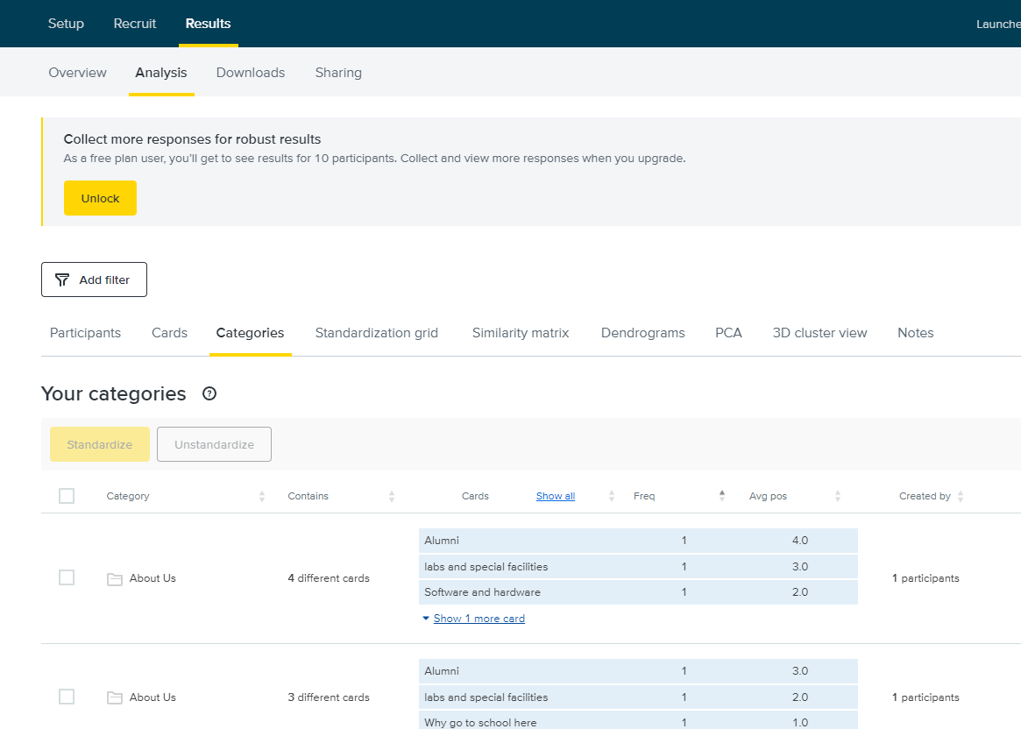
Categories

Slide 27
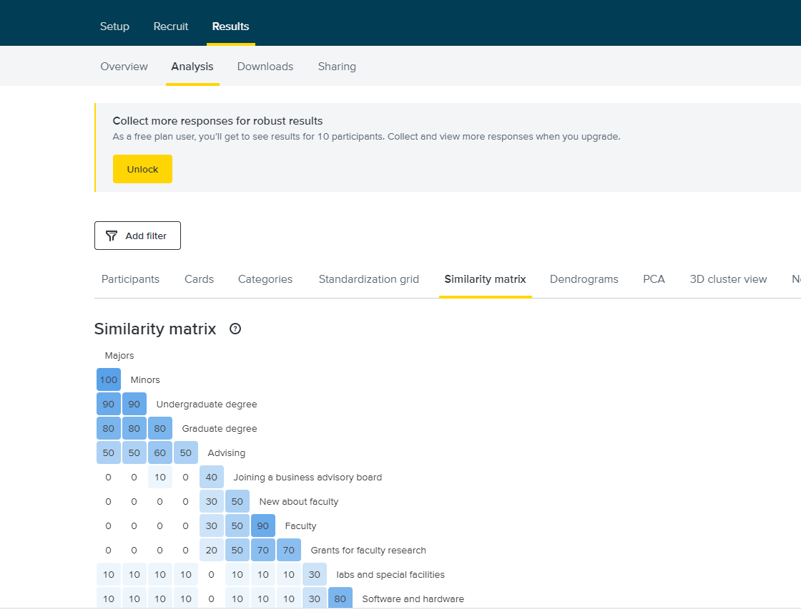
Similarity matrix

Slide 28
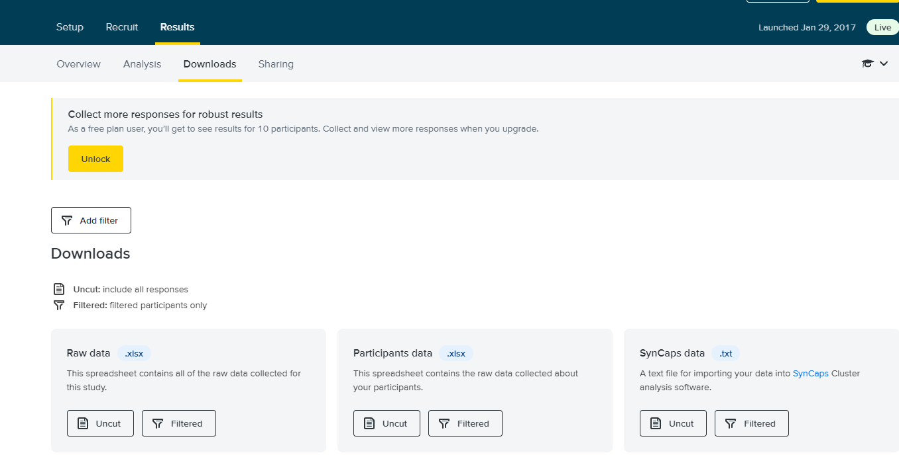
Download

